Slide 1



A short Briefing on Report Analytics

Slide 2

Report Analytics & Dashboard Analytics for Stake-Holders
01
Branch Dashboard
06
02
05
04
03

Slide 3
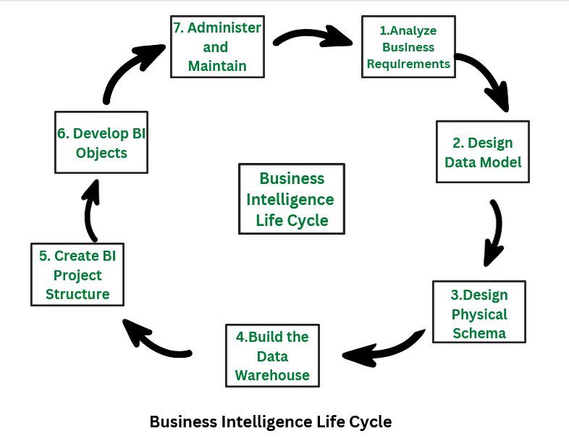

Slide 4
Report Analytics & Dashboard Analytics for Stake-Holders
Branch Dashboard
Branch dashboard to discuss New and renewal business number with each branch. This dashboard will be discussed between Corporate team and Individual branch heads.
Individual performance within the branch:
Target FY from Individual target sheet (New, Cross sell and Renewal) Fields to be referred (Column C, E, F and G)
Placed Achievement form Brokerage + Fees sheet (New, Cross sell and Renewal) (Brokerage sheet: Column G, J, M, K, L) (Fees Sheet: B, D, E, F, G)
Invoiced Achievement from Invoice sheet (New, Cross sell and Renewal) Column (B, F, G, J)
Percentage of Achievement for Placed and Invoice – (Achieved/budget)
No of meetings for current year – Meeting sheet (A, C, D)
Open Oppty – Opportunity report (Column: C, E, F, G) (Stage ‘Open’ Column G = Propose Solution & Qualify Opportunity)
Closed Won – Opportunity report (Column: C, E, F, G) (Stage ‘Won’ Column G = Won)
Conversion Ratio (Closed Won/Total Opportunity)
Further drill down to individual level top 10 open oppty and Win
KPI List
1-No of Invoice by Accnt Exec
2-Yearly Meeting Count
3.1Cross Sell--Target,Achive,new
3.1New-Target,Achive,new
3.1Renewal-Target, Achive,new
4. Stage Funnel by Revenue
5. No of meeting By Account Exe
6- Top Open Opportunity

Slide 5
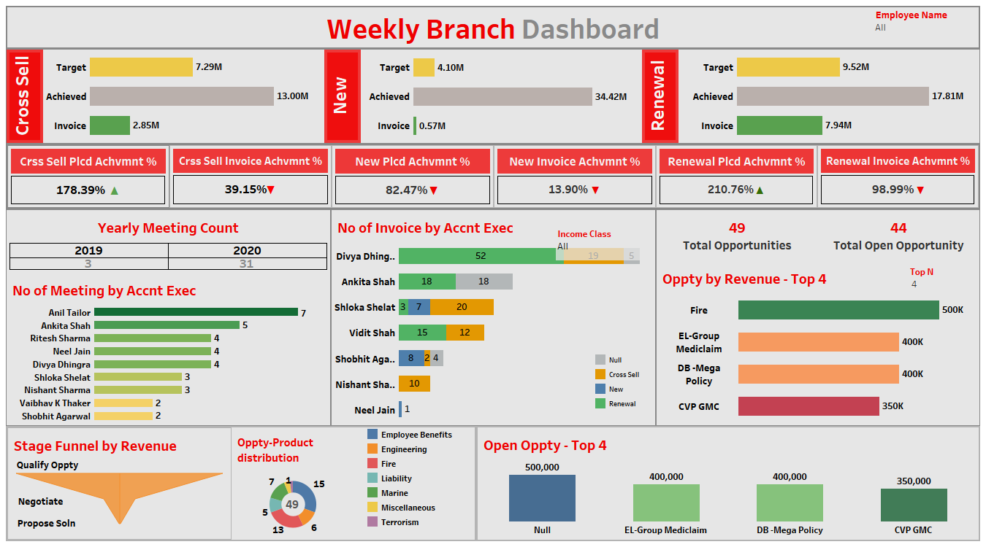
Report Analytics & Dashboard Analytics for Stake-Holders
Insurance Dashboard

Slide 6
Date | Time | Task Description
11-05-2023 | 10 AM – 11 AM | Project Kick-off Meeting
18-05-2023 | 10 AM – 11 AM | Implementation of KPI’s using Excel
25-05-2023 | 10 AM – 11 AM | Implementation of KPI’s using Tableau/SQL
01-06-2023 | 10 AM – 11 AM | Implementation of KPI’s using Power BI/SQL
08-06-2023 | 10 AM – 11 AM | Final Presentation of the Project

